Slide 1
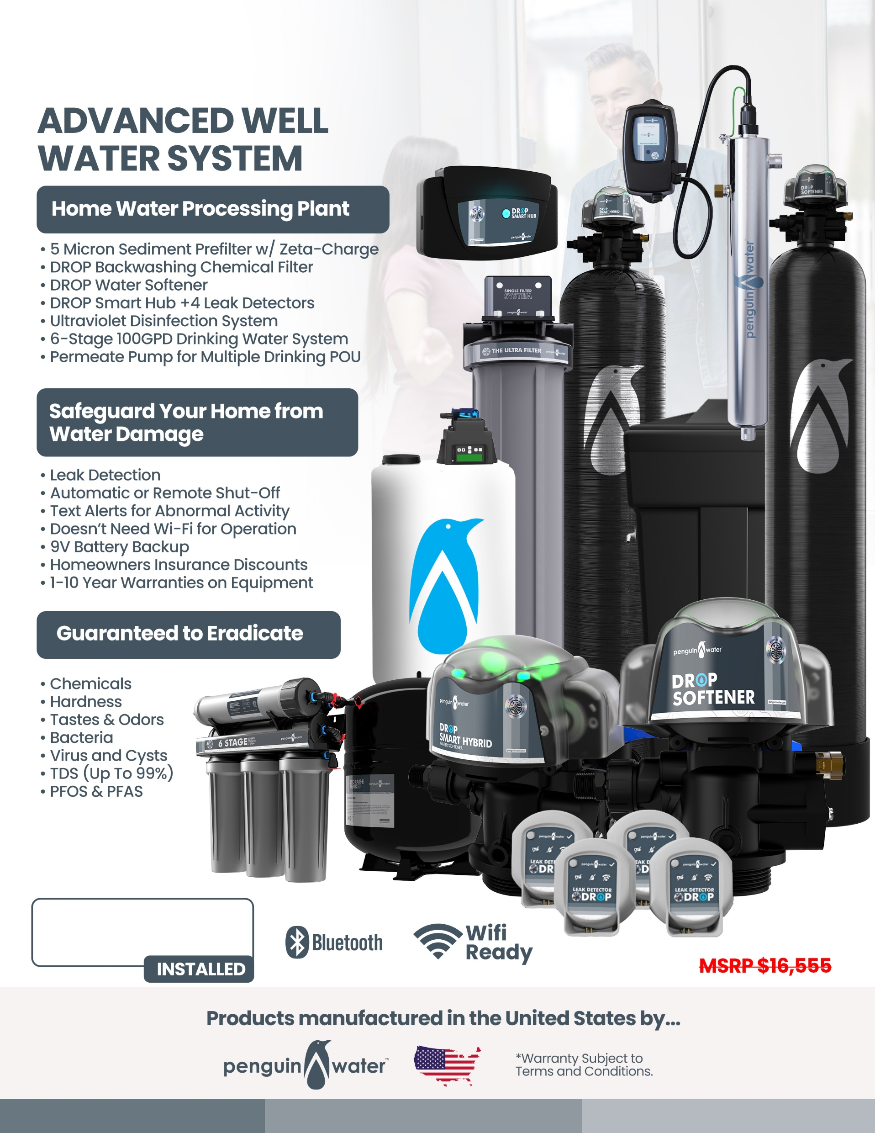
Your Logo Here
Your Price Here

